Slide 1

Structure Learning for Approximate Solution of Many-Player Games
Zun Li, Michael P. Wellman
Strategic Reasoning Group
University of Michigan

Slide 2
Motivation
Real-world multiagent systems involve an enormous number of interacting agents
Notes:
First let me introduce the motivation of this work
Many multiagent system we would like to understand involve an enumous number of agents
For example in Ad auction, the second you enter a keyword in the search engine, there may be hosting an auction that tens or hundreds of agents are competing for it
financial market, there are hundreds or thousands of traders and investors
in traffic routing, the system may want to coordinate cars and pedestrian within a district
and also one may be interested in how rumor spread over a social network, which consists of millions of people

Slide 3
Scaling to Many-Player Games
Intractable representational complexity for normal-form games: The game matrix for an N-agent, M-action game is of size O(NM^{N})
Researchers have proposed succinct game representations incorporating structural regularity, but hand-crafting game models with these is still difficult
We adopt a model-based approach: Simulation model + game model learning + succinct models
  Simulation models are free from the curse of dimensionality
  Data from simulation enable learning a succinct game model
  A succinct game model can facilitate equilibrium computation
Notes:
So game theory is standard mathematical tools for modeling multiagent system
But there is one caveat for traditional game theoretical analysis: the representational complexity of a game matrix is exponential with respect to the number of agent N
So more succinct representation is needed, and researchers did developed some kind of succinct game representation
But even that, they still need to hand-crafted game models, which could still be large amount of information to store when the number of player is large
So in this work, we combine three ideas to scale strategic reasoning for many-player games
First we will adopt simulation model for a game, where the information of the game come in the form of payoff data. So it will be free from the curse of dimensionality
The second is so-called game model learning, where we will use machine learning techniques to learn a representation of the game model,
And we will learn a succinct representation of it, which may offer some interesting structural property of the game of interest, as well as to facilitate equilibrium computaion

Slide 4
Empirical Game Theoretical Analysis (EGTA)
Game represented by a black-box simulator (or an oracle)
  Produces noisy samples of pure strategy payoff data: (a, u)
Selectively generate samples by feeding strategy profiles a
Estimate a game model based on samples (the empirical game)
Analyze empirical game model (e.g., compute Nash eq)
Notes:
So first I will introduce what simulation model means. This is what called empirical game theoretical analysis.
So in EGTA, the game is represented by a black-box simulator, where the information of the game is payoff samples
And the analyst constructs a normal-form game model called empirical game

Slide 5


Empirical Game Theoretical Analysis (EGTA)
Do not need to store the whole game matrix to compute an approximately good equilibrium
 | A | B | C
A
B
C
2.9,1.1
0,1
0,0
3,1
1,0.9
1,1
1,1
{<(A, A), (3.1, 0.9)>
<(A, B), (0, 1)>
…
}
{<(A, A), (2.9, 1.1)>
<(A, B), (0, 1)>
…
}
0,1
4,1
Notes:
Now I give a most naïve example to show you how egta works
Suppose we have a two-agent, 3-action game, and at the very beginning we know nothing about the payoffs
Then we queries some samples to the oracle, and get some payoff data, and each raw data point specify which action does each agent take and the corresponding payoffs, so both would be vector of length the number of agents
Then we will fill some of the game entry
In the next iteration, we further sample some data points, to refine the existing sampled entries or fill new ones
And now in this case we can assure that (U, U) is the nash equilibrium of the game with some certainty, because for now in the empirical game model there is no beneficial deviation here
So the idea is that we do not need to store the whole game matrix to get a approximatle good solution, and you can see that one typical question of egta is which region of the game matrix should we sample

Slide 6
Game Model Learning for Many-Player Games
Besides just filling game tabular, we can use machine learning techniques to generalize observed data to unobserved entries
The way we generalize it is to impose structural hypothesis
Notes:
Now we move onto the idea of game model learning

Slide 7
Full Game Space
Target Game
Final Hypothesis
Initial Hypothesis
Hypothesis Game Space

Slide 8
Iterative structure learning framework
Goal: Solve an unknown complex game by “fitting” it into a simple game
Game Model G
Payoff Function Regression
Equilibrium Computation
Structure S
Equilibrium σ*
Game Structure Learning
Query Oracle in Region of σ*
Data Buffer D
Oracle O
Notes:
Now we introduce the main contribution of this work, the iterative structure learning framework
In each iteration, we sample some data in the data buffer. Then first we use the data to learn a structure of the game
After which the structure and the payoff data combined together we learn the payoff functions of the game, which result in the empirical game model
Then we solve the game to get a mixed nash equilibrium \sigma_*
And since \sigma_* itself defines a probability distribution over pure actions, we use it as the sample distribution for the next iteration.
The whole idea is to exploit the structure of the unknown true game, particularly at those regions surrounding nash, so the function approximator can generalize better on those region

Slide 9
Iterative structure learning framework
Structure considering in this work:
1. Population structure -- Games with Symmetry
Our approach: use ”K-means”-like model learning algorithm
2. Interaction structure -- Games with Sparsity
Our approach: borrow ideas from structure learning for Bayesian networks

Slide 10
Succinct Games I – Games with Symmetry
Symmetric game: u_{i}=u, everyone share the same functional form, and only how many players play each action matters
  E.g., u_{i}(I drive, other’s actions)=u(I drive, #of drive, #of take train)
Role-symmetric game: agents are partitioned into different roles:
  suppose two roles commuter (c) and vacationer (v) then:
  u_{c}(I drive, others’ actions)= u_{c}(I drive, #of c drive, #of c take train, #of v drive, #of v take train)
The game is very likely to be encoded by smoothed functions!
Notes:
Next I will introduce the first type of structure – population structure, that is captured by game models with symmetry characteristics
So in a symmetric game, every player share the same functional form, and only how many players play each action matters
So for example …
A role symmetric game further generalize it by partitioning players into different roles, and only how many players in each role play each action matters
For example,…
The goodness of role symmetric is some kind of lipchiz continuity: for example, you would expect the payoff wouldn’t change too much if only one commuter switch from driving to riding.

Slide 11
K-Roles: Learning Role Symmetry
Employing number of roles K, iteratively learn a role assignment
Using unsupervised learning, similar agents are clustered into ”role agent” based on their payoffs under previous solution
The solution for “role-level game” is mapped back to individuals
Notes:
Now we introduce the first concrete algorithm of the iterative structure learning framework, where now we consider the hypothesis game space is all role-symmetric games of certain number of roles
The idea is we use unsupervised learning to cluster similar agents into one role. Where the similarity is defined by their payoffs
And the solution for the role-level game will be mapped back to individuals
It could be regarded as feature extraction of the true game

Slide 12



K-Roles: Learn Role-Agent Models
10-agent, 2-action game, assume K =3, start with arbitrary role assignment:
{⟨0 (2, 3, 1, 1, 1, 2), 31⟩
⟨1 (2, 3, 1, 1, 1, 2), 9⟩
…
}
𝟘
𝟙
𝟚
𝟛
𝟜
𝟝
𝟞
{⟨1 (2, 3, 1, 1, 1, 2), 15⟩
⟨0 (2, 3, 1, 1, 1, 2), 2⟩
…
}
{
⟨0111010011,(31,9,..)⟩
⟨0101110110,(4,19,..)⟩
…
}
{⟨0 (2, 3, 1, 1, 1, 2), 62⟩
⟨1 (2, 3, 1, 1, 1, 2), 103⟩
…
}
𝟟
𝟠
𝟡
Notes:
So just take a 10 agent 2 action game for example
We start with an arbitrary role assignment, where here each color represent a role
And suppose we sample a dataset, then we first preprocess the dataset, by first separate data for each roles based on the current role assignment
Then for each raw data point we calculate the feature vector, which is just by counting how many players of each role choose each action
And then we feed the action, feature, payoff into the function approximators to train the role agents
Suppose now we use neural networks

Slide 13
K-Roles: Equilibrium Computation
𝟘
𝟙
𝟚
𝟛
𝟜
Compute NE 𝞼* based on role-agent models
𝟝
𝟞
Map strategies 𝞼* back to players, based on role assignments
𝟟
𝟠
𝟡
Notes:
And then we let the neural networks play a role-level game and get some mixed nash equilibrium
Then we map back the solution onto the individual level, serving as the solution for this iteration

Slide 14
K-Roles: Cluster Determination
𝟘
𝟙
𝟚
𝟛
𝟜
Estimate individual payoffs when others act according to 𝞼*
Use those as agent embeddings
Re-cluster based on embeddings
𝟘
𝟙
𝟚
𝟛
𝟜
[1, 10]
[4, 5]
…
[-1, 10]
𝟝
𝟞
𝟝
𝟞
Sample according to 𝞼*
[1, 7]
[1, 10]
𝟟
𝟠
𝟡
𝟟
𝟠
𝟡
[6, 1]
[1, 10]
[-1, 10]
Notes:
To refine the cluster for the next iteration, we first represent each agent as some vector embedding, and do unsupervised learning on these vector embeddings.
The embeddings are constructed as follows. First we sample a data set according to sigma stat, then use data set, we can estimate the payoffs of each individuals when it choose some pure action while others acting according to sigma*

Slide 15
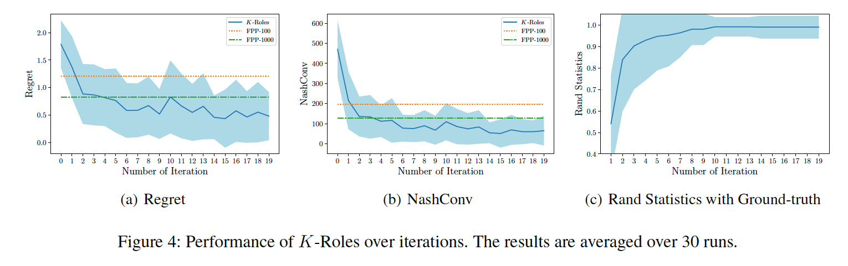
Experiments for K-Roles
300-agents, 3-actions, 3-role symmetric game:
Notes:
The first two figures measures how close our equilibrium result in each iteration to the equilibrium of the true game
The third figure use a metric that measures how close our partition structure close to the ground truth partition

Slide 16
Succinct Games II – Games with Sparsity
Graphical game [Kearns et al. 2001]: only my neighbors’ choices matter: u_{i}(I vote left, other’s votes)=u_{i}(left, my neighbors’ votes)
Exist an underlying graphical model describing interaction structure: each agent is an node
The game is represented by a ”coarsened” game matrix
Notes:
The second type of structure is interaction structure, where games with sparsity property – graphical game capture such structure
So in a graphical game, there is an underlying graphical model for the game
And the payoff of one only depends on its action, and the action choices over its neighborhood
So a graphical game can be regarded as a coarsened game matrix

Slide 17
Greedy Graphical Game Learning: Learning Graphical Structure
Employing maximum neighborhood size 𝜅
First designing a payoff training loss. Starting from a graph with no edge, we greedily add an edge that decreases loss the most
The approach is also analog to the score-based structure learning for Bayesian network
Notes:
We borrow the idea of structure learning for Bayesian network here
The approach is to use payoff training loss to greedily learn a graphical model
And it could also be regarded as feature selection for the true game

Slide 18

G3L
N=5, 𝜅=3, for one agent:
Training Loss +1
Training Loss -7
Training Loss +3
Training Loss -1
Training Loss +3
Training Loss +7
Training Loss -1
Training Loss -5
Training Loss +5
Training Loss +1
Training Loss +2
Training Loss +4
Training Loss -10
Training Loss -2
Training Loss -2
Training Loss +2
Training Loss -1
Training Loss +10
Training Loss -10
Training Loss +10
Training Loss -1
Training Loss -5
Training Loss +5
Training Loss +1
Notes:
For the time saving, let me just briefly illustrate how G3L works
So we for each agent, we will use payoff loss to learn a neighborhood set for that agent.
Each time we will add or delete an agent that will decrease the training loss the most
So let’s look at a 5-agent game, and we would like to learn the neighborhood for the central agent
Then at this point we should add the bottom left agent,
Then the top left agent, then the top right agent
Then we observe that if we delete the bottom left agent the training loss would decrease the most, so we are permitted to do that
Then at the end we result in the three agent in the neighrhood set.

Slide 19
G3L Payoff Estimation & Training Loss
Suppose now for a 5-agent, 2-action game, we estimate agent 1’s neighborhood 𝙉(1) = {1, 2, 4}.
To estimate the payoff for u₁(a₁=0, a₂=1, a₄=0), we just set this value as the average of all those (u)₁, such that (a, u)∊D and (a₁=0, a₂=1, a₄=0) is contained in a.
The training loss is defined as the mean square error between the payoffs in the training set and the above estimation
Notes:
First lets specify what training loss look like
Suppose now we consider a 5-agent 2-action game, and now we estimate 1’s neighbor hood 2,4
So to determine the payoff when player 1 chooses U, 2 chooses L, 4 chooses U, we just set this value as the average of all those payoff samples of 1 in the training set, such that the joint profile is a sub-vector in the corresponding action sample
And the training loss is just the mean square error for the training set

Slide 20
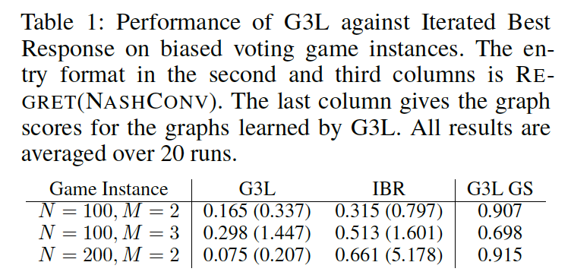
Experiments for G3L

Slide 21
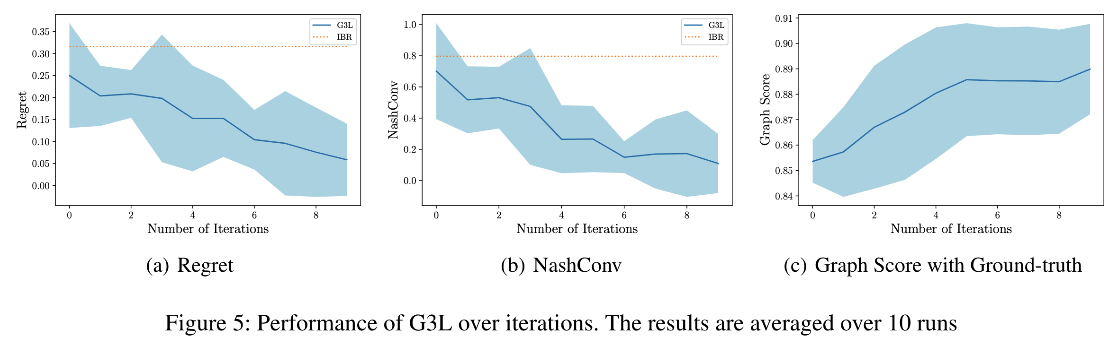
Experiments for G3L
100-agent 2-action graphical game:

Slide 22
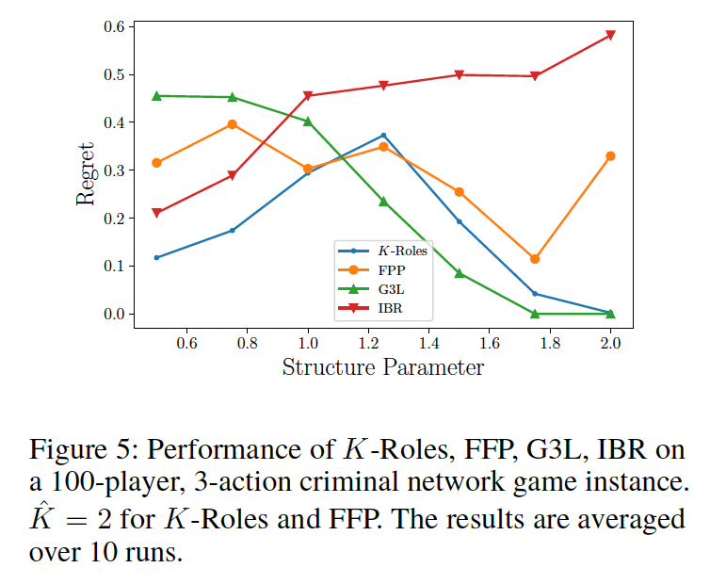
Experiments comparing K-Roles and G3L
Criminal network game: a class of game that defines a spectrum of game instances between perfect symmetry and perfect sparsity
When the game approaches a graphical game from symmetric game, K-Roles is able to find solution nearly as good as found by G3L
Notes:
For the last experiment, we test all the methods on a game that is a kind of mixture of symmetry and sparsity
So in this class of game model, there is a structure parameter defines a spectrum of games between perfect symmetry and perfect sparsity, so at the origin, it is symmetric game, while at the other extreme it is graphical game
So first we can see K-Roles and G3L does outperform the others if the game is close to the symmetry extreme or the sparsity extreme
But another interesting observation is that, when the game is approaching a graphical game from a symmetric game, K-roles is able to find those solutions that are nearly as good as those found by G3L, suggesting that symmetry could arise from sparsity in a game.

Slide 23
Conclusions
This work proposed a model-based approach for learning-and-solving a many-player game where the only game descriptors are the set of agents and the set of actions
Proposed two algorithms for different game structure hypothesis: K-Roles for role-symmetry game and G3L for graphical game

